Slide 1

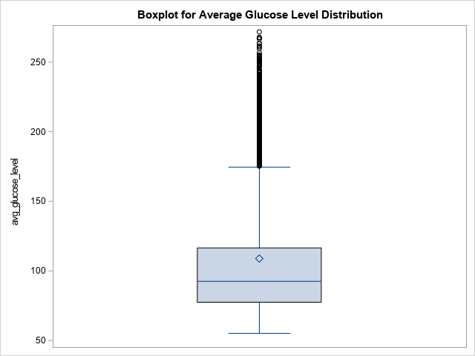
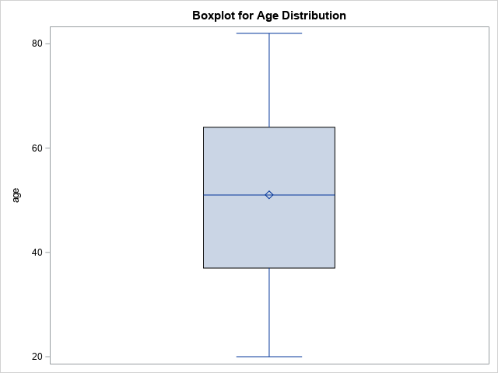
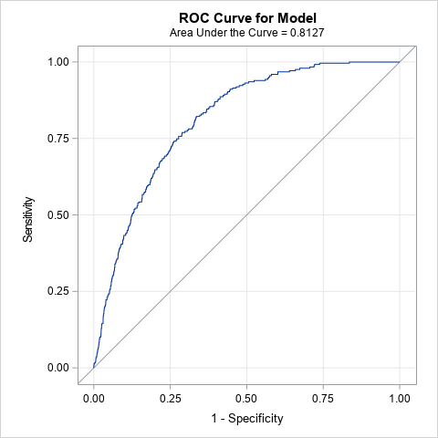

Stroke and Heart Disease Prediction
Richard Murad, Kennesaw State University
Faculty Advisor: Dr. Marla M. Bell
INTRODUCTION
Figure 1: Boxplot distribution of Quantitative Variables
RESULTS/INTERPRETATIONS
With stroke and heart disease ranking among the top five leading causes of death in the United States, it is crucial to adopt a data-driven approach that address these public health challenges. Stroke occurs when there is a sudden interruption of blood flow to the brain and heart disease refers to any condition that affects the cardiovascular system in a negative way. Both tragedies are affecting the core parts of our bodies, resulting in detrimental consequences. By using advanced statistical modeling and analysis of a 4143-sample dataset, our goal is to break down the relationships between variables like age, glucose levels, hypertension, smoking status, and gender to predict the likelihood of individuals developing heart disease and stroke. This approach will not only provide insights into the roots of these medical conditions but will also supply healthcare professionals with the tools needed to make credible decisions for their patients.
Stroke Interpretations
An increase in age by one year is associated with an increase in odds of experiencing stroke by approximately 7.4%, given that all other variables are held constant. This relationship was observed in the subset of patients aged 20 years and over.
An increase in average glucose level in the blood by one milligram per deciliter (mg/dl) is associated with an increase in odds of experiencing stroke by approximately 0.4%, given that all other variables are held constant.
As compared to patients who do not have high blood pressure, patients who do have high blood pressure are associated with an increase in odds of experiencing stroke by approximately 46.5%, given that all other variables are held constant.
Heart Disease Interpretations
An increase in age by one year is associated with an increase in odds of experiencing heart disease by approximately 8.2%, given that all other variables are held constant. This relationship was observed in the subset of patients aged 20 years and over.
An increase in average glucose level in the blood by one milligram per deciliter (mg/dl) is associated with an increase in odds of experiencing heart disease by approximately 0.6%, given that all other variables are held constant.
As compared to being female, being male is associated with an increase in odds of experiencing heart disease by approximately 118%, given that all other variables are held constant.
As compared to patients who’s never smoked, being a smoker is associated with an increase in odds of experiencing heart disease by approximately 103.7%, given that all other variables are held constant.
Table 1: VIF Values for Both Models
METHODS/ASSUMPTIONS
A couple of methods were implemented before running the logistic regression models. To start with, a subset of the variable age was applied to eliminated all patients under 20 years old due to unusual, low decimal values; these values might have been imputed. Additionally, there were many variables in our dataset, indicating that at least one variable will be insignificant towards the response variable. To address this potential issue, a variable selection method was utilized, more specifically, a stepwise regression. The entry level significance at .10 and the staying level significance at .05 enabled us to have interpretable independent variables.
Regarding assumptions, the variance inflation factor was included to assess multicollinearity among all predictor variables for both models. Of course, all the variables needed to be quantitative, so a data step method in SAS was necessary to recode the categorical variables (gender and smoking_status) into integers. There is also an obvious sign of skewing in our boxplot distribution of average glucose levels, but the sample of 4143 patients is large enough to be normally distributed via the central limit theorem.
Figure 2: ROC Curve for Stroke Model (left) and Heart Disease Model (right)
DISCUSSION
CODE FOR SAS PROCEDURES
The presented results provide us insights into the odds factors of stroke and heart disease. All these findings make intuitive sense except for the gender variable;
a recommended future study is to investigate the reasons why males have significantly higher odds of experiencing heart disease than females. Unlike age and gender, most of these variables are modifiable through lifestyle changes and medical management:
Modifiable Variables
Stroke: Average glucose level and high blood pressure (hypertension)
Heart Disease: Average glucose level and smoking status
By lowering average glucose levels and hypertension, as well as putting an end to smoking, individuals can make positive lifestyle changes and reduce their vulnerability to these serious conditions.
*Variable Selection Model 1;
proc logistic data = stroke1;
class smoking_status gender residence_type ever_married;
model stroke = age bmi smoking_status avg_glucose_level heart_disease hypertension gender residence_type ever_married
/selection = stepwise slentry = .10 slstay=.05;
run;
*Variable Selection Model 2;
proc logistic data = stroke1;
class smoking_status gender residence_type ever_married;
model heart_disease = age bmi smoking_status avg_glucose_level stroke hypertension gender residence_type ever_married
/selection = stepwise slentry = .10 slstay=.05;
run;
*Model 1;
proc logistic data = stroke1 descending plots=(oddsratio(cldisplay=serifarrow) roc);
class hypertension(ref='0');
model stroke = age avg_glucose_level hypertension / lackfit aggregate scale=none ;
run;
*Model 2;
proc logistic data = stroke1 descending plots=(oddsratio(cldisplay=serifarrow) roc);
class smoking_status(ref='never smoked') gender(ref='Female');
model heart_disease = age avg_glucose_level smoking_status gender / lackfit aggregate scale=none;
run;
Table 2: Odds Ratio Estimates

